Slide 1
Earthquake
Prediction
Mahesh
Swapna
Rohit
Akshay
Chaitanya

Slide 2
Earthquakes

Slide 3
Earthquakes
Tectonic plates
High
Tempratures
Gravitational
movemmets
Aged and dry
Rock
Diversity

Slide 4
Earthquakes
Tectonic plates
Rock
Diversity
Gravitational
movemmets
High
Tempratures
Aged and dry

Slide 5
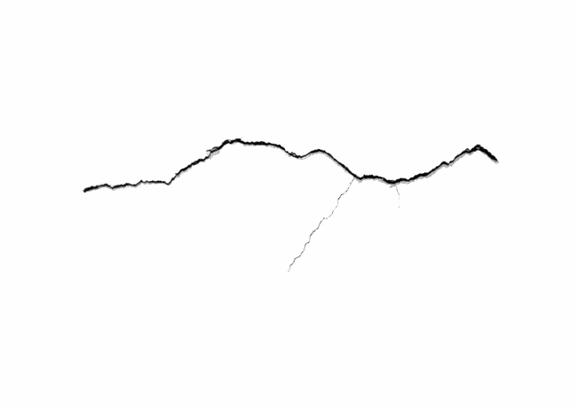
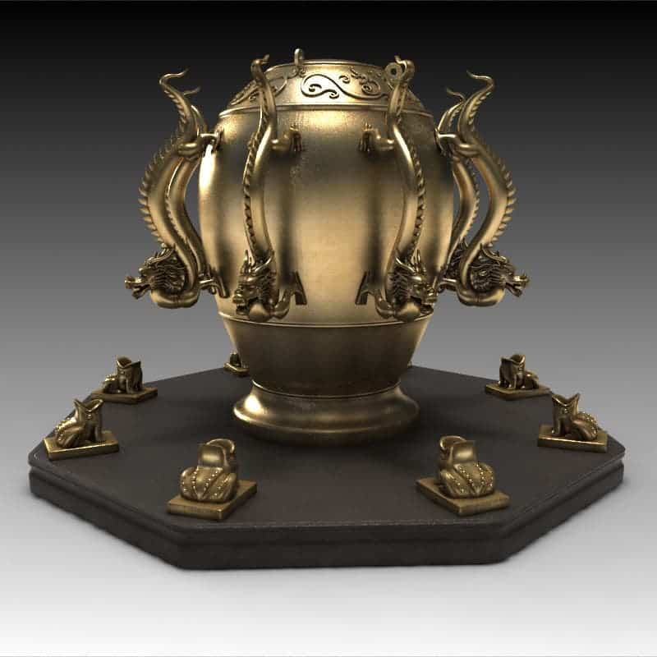
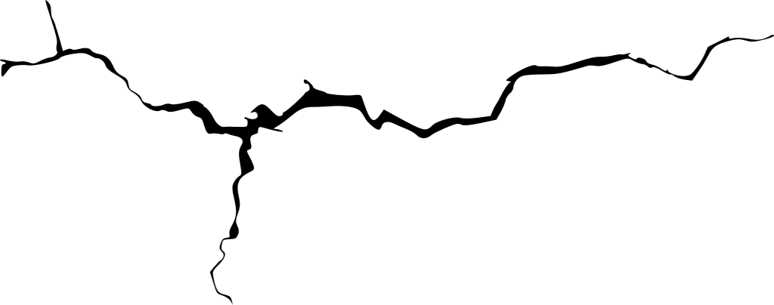
Earthquake Prediction
The first ever recorded instrument to predict earthquakes was made in 132 AD by Chinese scholar Zhang Heng.
Scientists think this had a very sensitive pendulum that would make the dragon heads (pointed in various directions) drop a ball into the toads below.
This method is outdated and unreliable today but it proved very efficient during its invention as it helped the Emporer send aid to the required in a timely manner.
This device was also known to detect an earthquake of magnitude 7 in a village 400 miles to the west! Quite impressive for 2000 years ago.

Slide 6
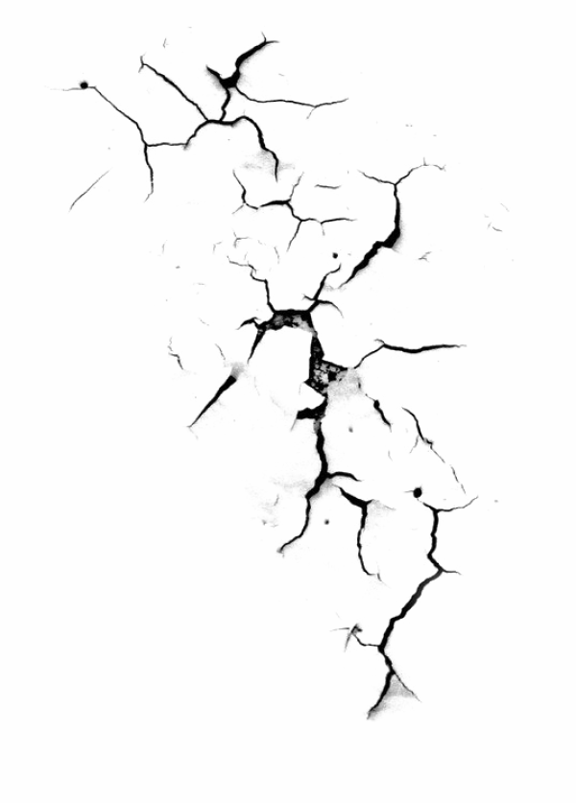
Earthquake Prediction
Even though we are 2 millennia ahead of Zhang, we still do not have a reliable way of predicting earthquakes.
We can only calculate the probability of earthquakes based on previous data.
A prediction must have three elements according to the USGS:
Date and time
Location
Magnitude
But we do have some methods that can help us assess the situation to some degree.

Slide 7
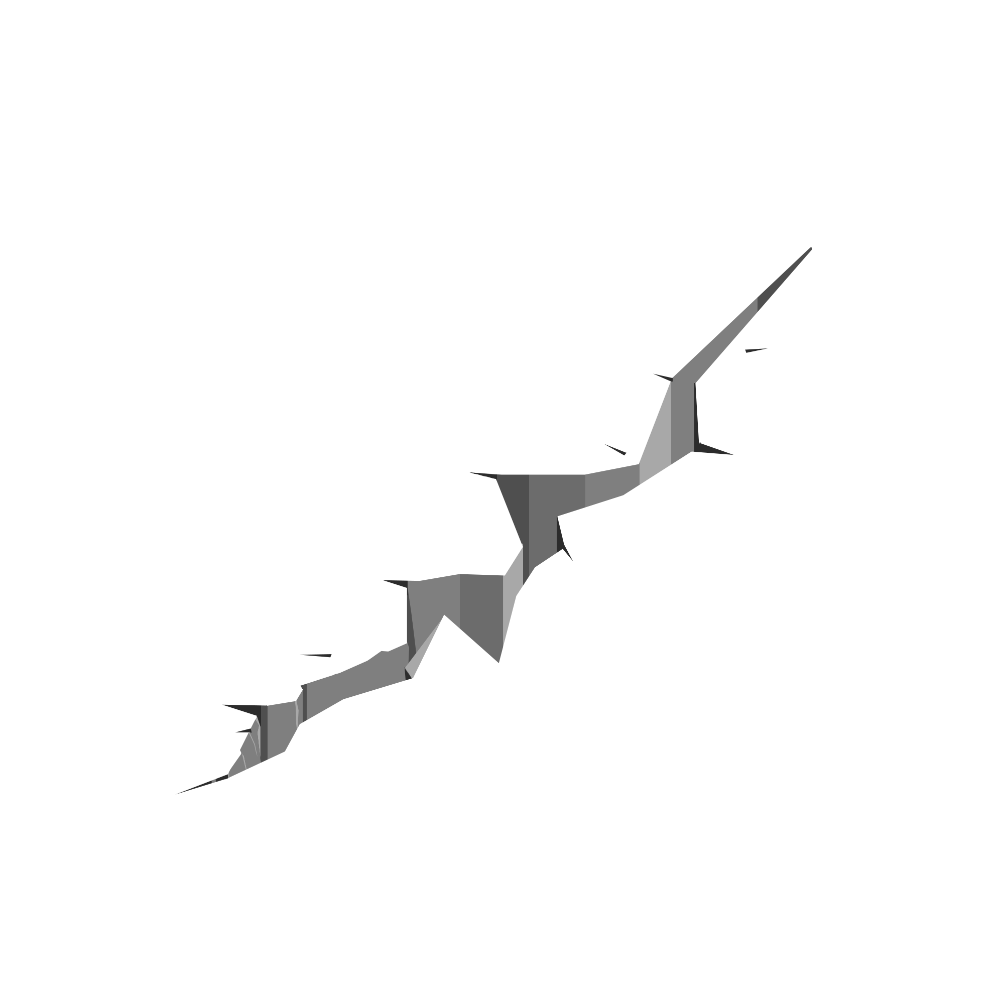
Radon Emissions
In 2011, an earthquake of magnitude 9.1 occurred on the east coast of Japan and hit the country with a devastating tsunami.
Interestingly, scientists in South Korea detected high concentrations of Radon and Thoron isotopes in the area before it happened.
Scientists suspect these isotopes escaped through microfractures in the earth's surface when there is friction between tectonic plates.
Similar spikes were also reported in China, India and Tashkent. Radon detectors in vulnerable areas might be a viable solution to predict earthquakes.

Slide 8
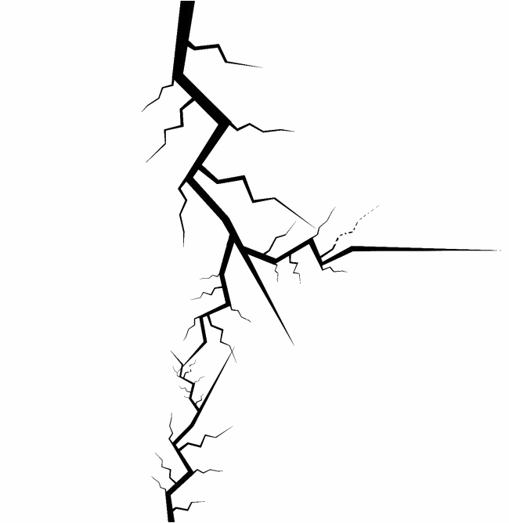
Hydrochemical changes
In seismically active regions of the Middle East, an increase in the dissolved minerals levels in the groundwater was noticed.
The levels remained consistent during the inactive period and disappeared after the earthquake occurred.
Similar anomalies were observed in India during the 1997 Jabalpur earthquake.
More research in technology that can detect this can also result in a reliable way to predict earthquakes.

Slide 9
Temperature and Water level changes
A strange relationship was observed between temperature and earthquakes. Some areas in China and Russia observed a rise in temperature by 10 to 15 degrees Celcius.
These observations were made around 10-30 Km of the epicenter.
Drastic changes in water levels were also observed in the same places.
China and Russia saw a rise in the water level whereas Japan saw a fall in the water levels before an earthquake.
Proper Technology to monitor these levels in vulnerable areas can help improve our chances of predicting earthquakes.

Slide 10
Animal Behavior & Foreshocks
Many animals are blessed with much stronger sensory capabilities than humans. They can perceive and recognize things that we cannot.
Though not completely reliable, it is best not to ignore the unnatural restlessness of animals and birds.
Many major earthquakes are preceded by smaller shocks in the ground which are termed as foreshocks.
Quite a few earthquakes have been predicted successfully on the basis of the study of foreshocks.

Slide 11
THANK YOU

